Slide 1
Software Product Management Specify product features – Story Map
Nandagopal Govindan

Slide 2
Contents
Story map
Classification of features: Kano model
Exercise

Slide 3
Introduction
Once we have understood the need and we have assessed the need by interacting with customers & users, we need to capture all the requirements / features / functionality
Story map is an effective tool to capture the features
Invented by Jeff Patton

Slide 4
Story map: Job portal
Find job
Manage vacancy
Recruit candidate
User
Activities
(backbone)
Browse jobs
Post resume
Receive job alert
Post vacancy
Cancel vacancy
Search candidates
Contact
candidates
User
Tasks
(skeleton)
Search jobs (basic)
Upload resume - PDF
Subscribe for job alert
Submit job vacancy
Select job vacancy
See job applicants
Send message
Search jobs - location
Upload resume – MS Word
Receive SMS for newly posted jobs
Remove job vacancy
Read message (applicant)
User
stories
Build resume with resume builder
Receive SMS alert - last date approaching
Send interview request
Respond to interview request
https://www.visual-paradigm.com/guide/agile-software-development/what-is-user-story-mapping/

Slide 5
Story map: Job portal
Find job
Manage vacancy
Recruit candidate
User
activities
Browse jobs
Post resume
Receive job alert
Post vacancy
Cancel vacancy
Search candidates
Contact
candidates
User
tasks
Search jobs (basic)
Upload resume - PDF
Submit job vacancy
Select job vacancy
See job applicants
Send message
Release
1
Search jobs - location
Upload resume – MS Word
Remove job vacancy
Read message (applicant)
User
stories
Build resume with resume builder
Subscribe for job alert
Receive SMS alert - last date approaching
Send interview request
Release
2
Receive SMS for newly posted jobs
Respond to interview request
https://www.visual-paradigm.com/guide/agile-software-development/what-is-user-story-mapping/

Slide 6
About Story map
Story map
Uses top down
Helps organize features based on importance
Helps plan releases

Slide 7
Exercise
Create story map for:
Hotel booking software

Slide 8
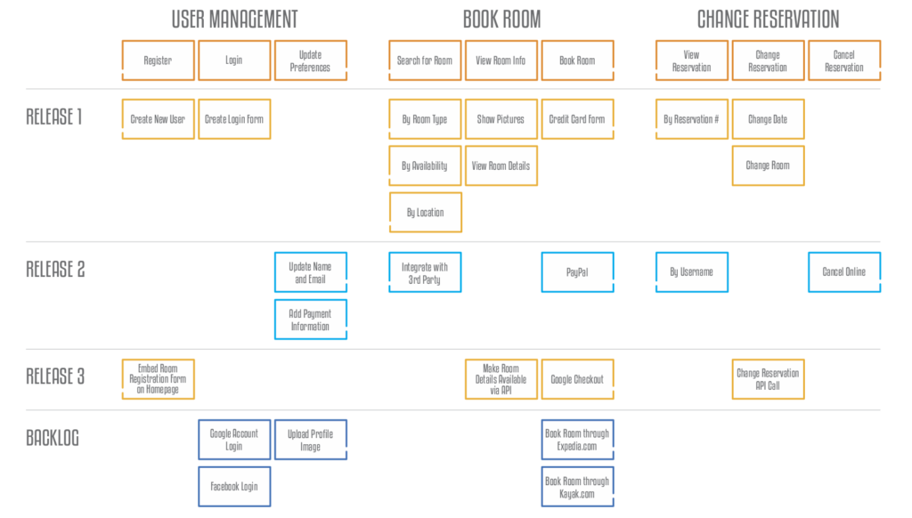
Solution

Slide 9
We need to classify and prioritize features: Kano model
Classification of product features:
Must have
Wants
Delighters

Slide 10
Classification of features: Example: Laptop
Must have | Wants | Delighters
2 Ghz CPU 4 MB RAM 1 TB Disk | OS pre-loaded Anti-virus Finger print scanner Touch screen Dolby sound Log battery life Light weight | Green PC (low power consumption) Spill proof (water proof) key board 4G card for internet

Slide 11
Classification of features: Job portal software
Must have | Wants | Delighters
Post vacancy Apply View applicants | Get job alert Hot job indicator | Resume builder Good Interview videos Tips to negotiate salary Psychometric test

Slide 12
Classification of features: Job portal software
Must have | Wants | Delighters
Post vacancy Apply View applicants | Get job alert Hot job indicator | Resume builder Good Interview videos Tips to negotiate salary Psychometric test

Slide 13
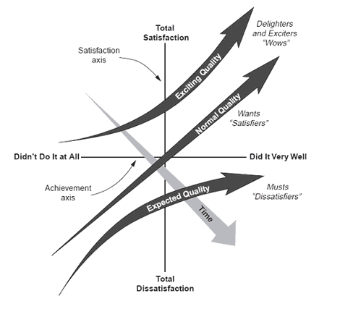
Classification of features changes over time…
As people start using the products, some features move on from Wants to Must haves and Delighters to Wants.

Slide 14
Classification of features changes over time…
Example of delighters becoming wants: Job portal software
Must have | Wants | Delighters
Post vacancy Apply View applicants | Get job alert Hot job indicator | Resume builder Good Interview videos Tips to negotiate salary Psychometric test

Slide 15
Exercise
Identify ‘Must have’, ‘Wants’ & ‘Delighter’ features of
Online banking
Airline reservation
eCommerce

Slide 16
Appendix

Slide 17
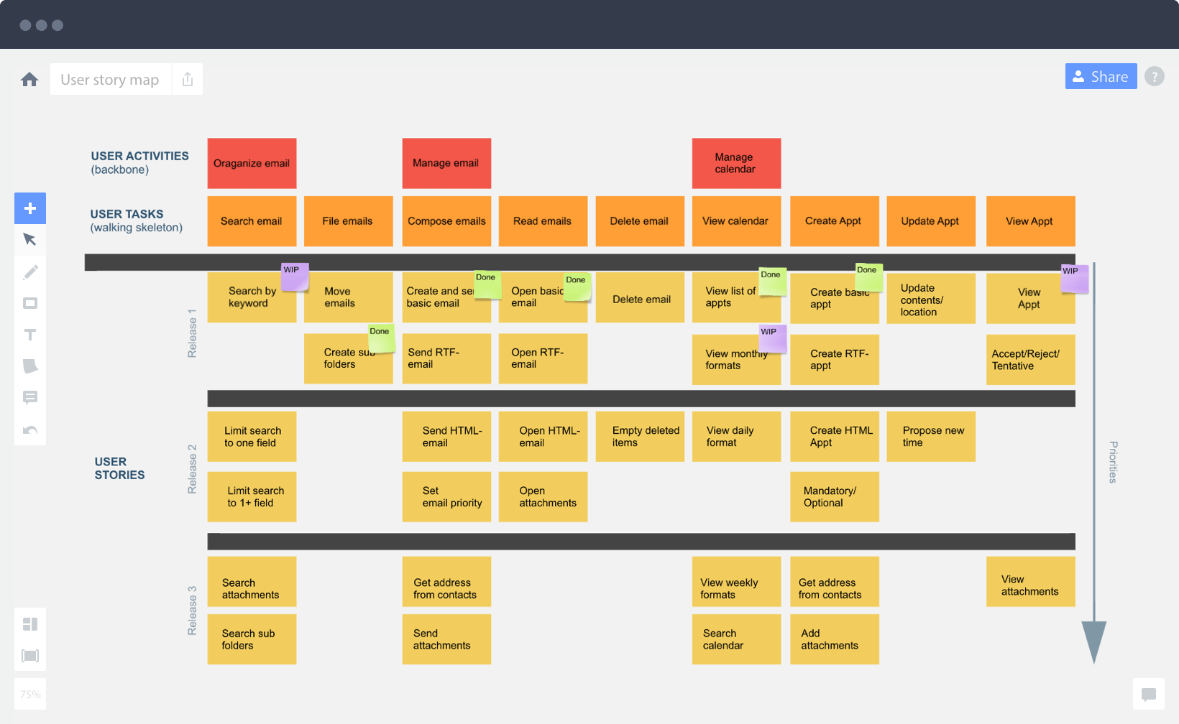
Story map: Email system
https://medium.com/@mal.sanders/top-5-takeaways-from-user-story-mapping-by-jeff-patton-f8c80cf73750

